Slide 1
WEB PORTAL ON HEALTH CARE
Presented By :- Sohan Sakhare (TEIT_59)
Kaustubh Patil (TEIT_47)
Antima Yadav(TEIT_68)
Guide :- Rupali Sathe

Slide 2
CONTENT
Introduction
Scope of the system
Literature survey
Problem statements
Objective
Hardware & software requirement
Methodology
Flow chart
Advantages
Conclusion
References

Slide 3
Introduction
There is an increased interest in the adoption of e-healthcare solutions and the fundamental change on how patient records, service provider communications, and appointment scheduling can be delivered.
An e-Health portal is a secure online web portal that gives patients convenient, 24-hour access to personal health information from anywhere via an Internet connection, often “tethered” to their integrated electronic health records.
e-Health portals save the patient time, also keep them organized, up to date, and deliver a higher overall level of convenience.
Our project web portal for health care is developed so that the patient can know there consultant by their own and also choice the best one.
It fulfill the gap between patient and the service provider.

Slide 4
Scope of System
The health care sector is one of the world’s biggest and fastest-developing sectors and is about 12 % of GDP for most of the developed countries while in India its 5% of the GDP.
The scope of healthcare industry is tremendously widening, bringing in enormous opportunities in terms of employment and revenue.
With the immense growth of the healthcare industry, huge investment, various government schemes and an increasing number of private hospitals, the career scope in Healthcare sector is increasing exponentially.

Slide 5
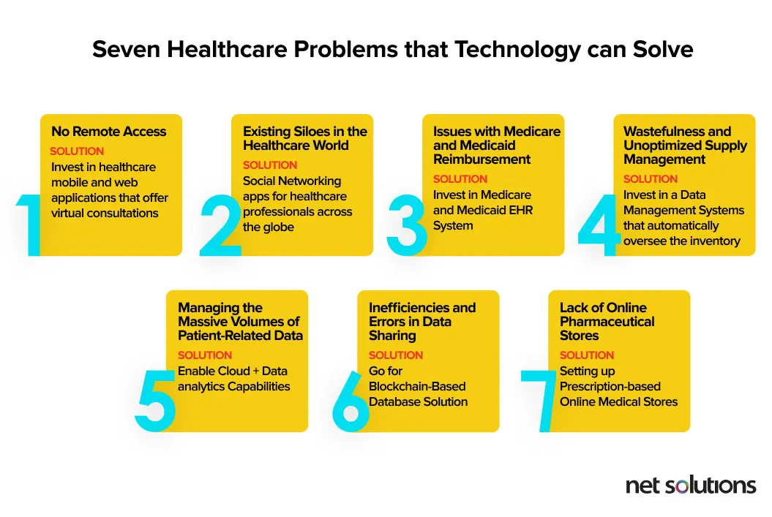
Problem Statements

Slide 6
Objectives
Web health care portal continue to grow the flexibility and performance abilities of these remote-oriented platforms. To creates a reliable experience for medical experts to provide quality care and advice to patients from miles away.
Doctors can focus more on their core functionalities and offer effective coordinate care with other doctors to plan cohesive, personalized treatment plans.
These solutions provide healthcare professionals with real-time access to patient-related data like registrations, medical history, diagnoses, treatments, and more.

Slide 7
Literature Survey
During our survey we had found many of the website for health care they have many of the module which are brainstorming but there is lack of simple need of the users.
With the help of IEEE we have read more than 5 paper and they have many more to it .
Some of them are
*https://ieeexplore.ieee.org/document/941724/

Slide 8





Hardware & Software Requirements

Slide 9
Methodology
To solve the problem statement of the e-healthcare we had come to some of the process step by step.
Firstly we research for the problem suffer by the patient and
Come up with the solution and add some of module to our portal
Some reference from internet and design the front end of the website

Slide 10
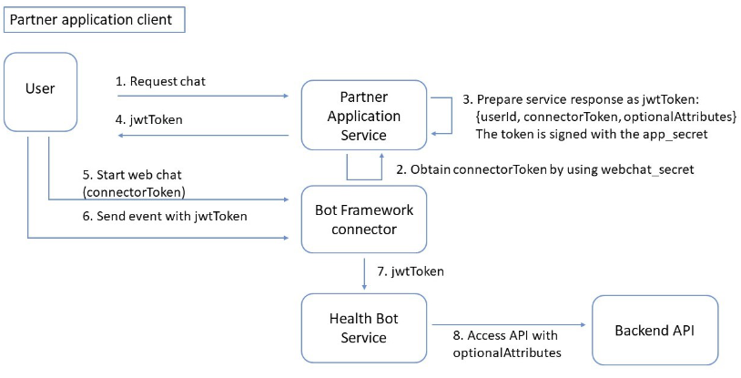
System flow

Slide 11
Advantages
1. It enables 24/7 online presence
2. It helps in relevant information exchange
3. Builds Credibility
4. Cost Effective:
5. Expand Your Reach
6. Patient Insights
7. It allows smooth customer service online

Slide 12
Conclusion
There’s no denying that the healthcare industry has come a long way as technology continues to take on a role of prominence in this industry. From dealing with data overload across various institutions to connecting doctors and patients from opposite ends of the globe via Web page , healthcare technology continues to advance in the right direction.
We may presently be viewing just the tip of the iceberg in terms of what mobile apps, cloud-based services, and other digital assets have to offer to healthcare professionals. Digital transformation in healthcare is expected to be seen more prominently in the coming times and will bring exciting opportunities in the industry for doctors as well as patients.
At the end this portal will be helpful for all the people who want to be able to move from their place and those who aren't able to reach the hospital and diganos their diseases on proper time .

Slide 13
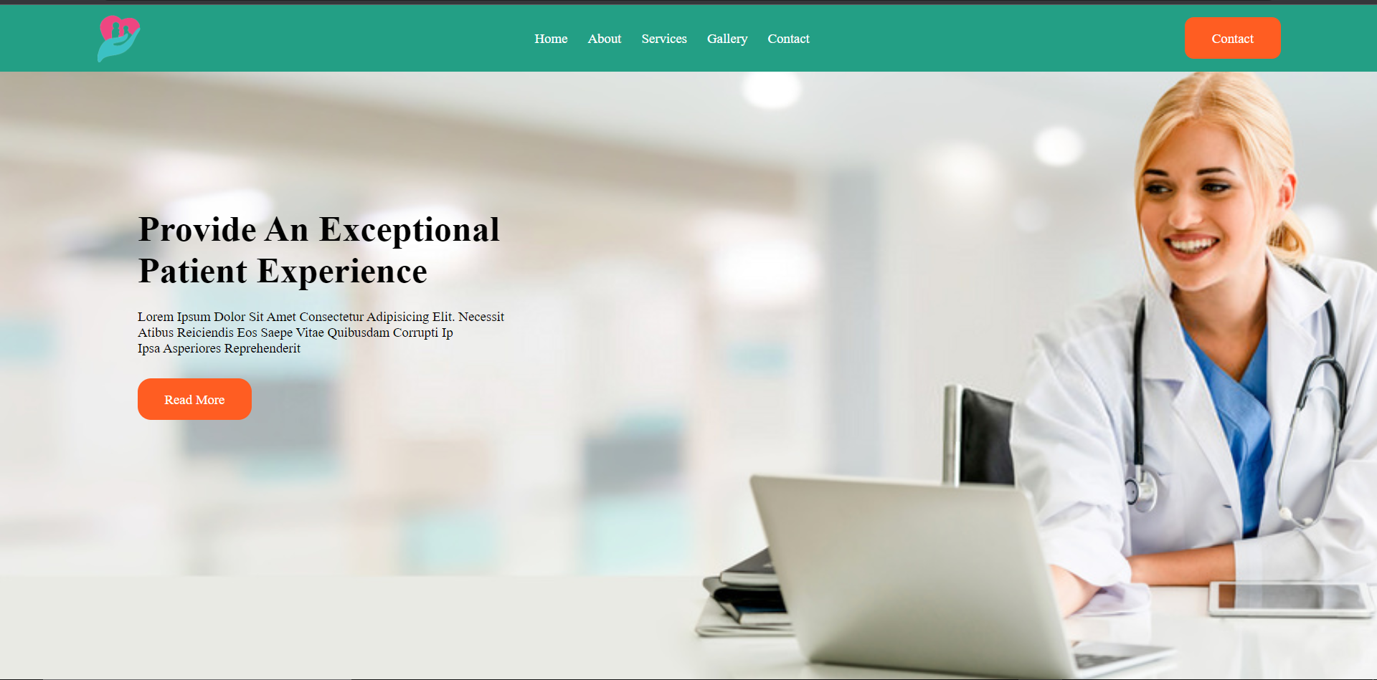
Screenshots

Slide 14
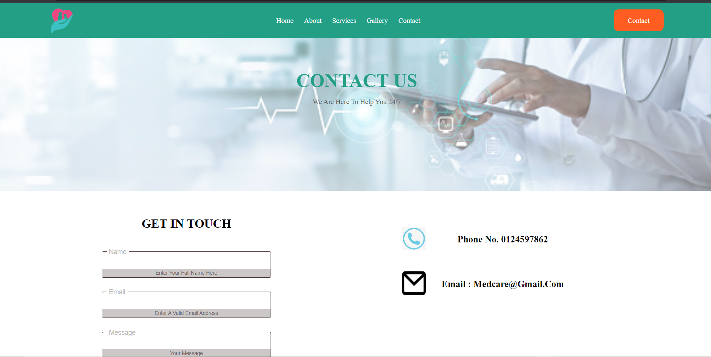
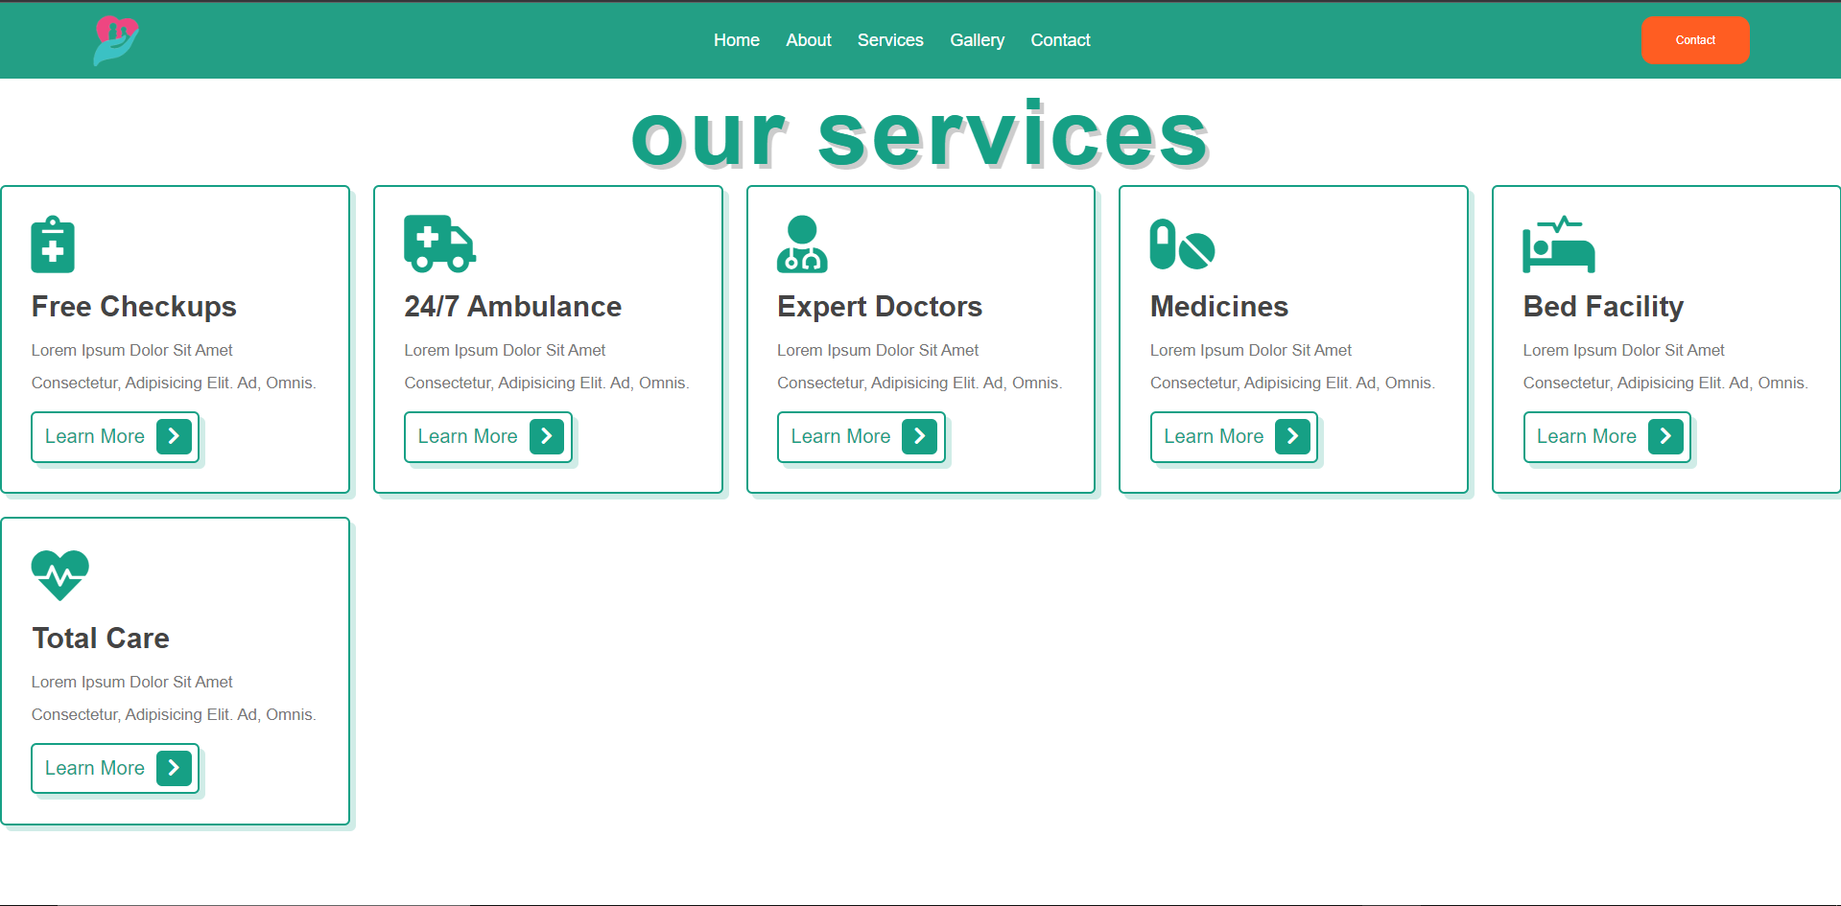

Slide 17
References
https://github.com/
https://www.geeksforgeeks.org/

Slide 18
THANKYOU

